Slide 1
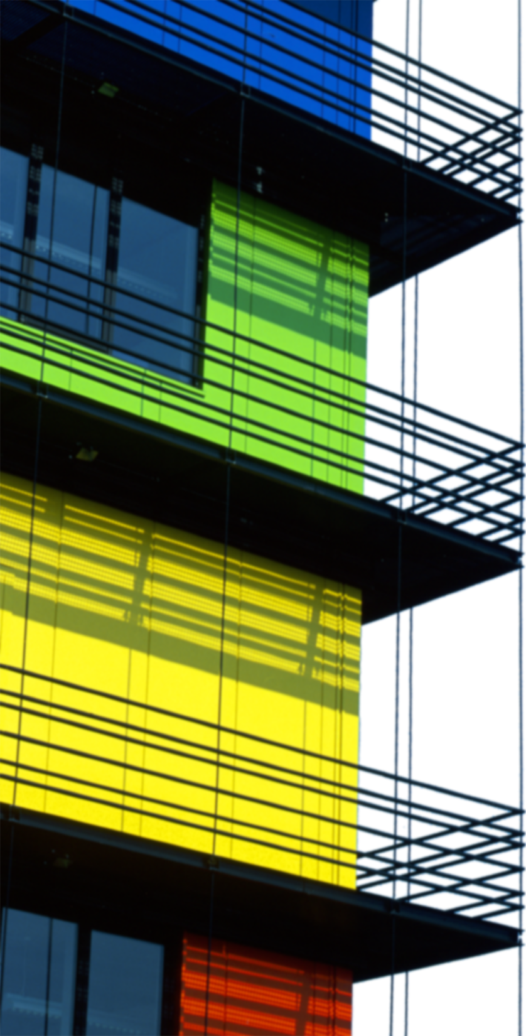
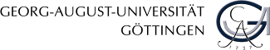
Numerical simulation of physical systems
C. Lehrenfeld, C. Nowak
www.xlab-goettingen.de

Slide 2
Does physics work for real systems?
Physics works for idealized systems
Smartphone works
Real systems show significant deviations
Airplane works
Contradiction?
Physics: Investigating simple systems to gain knowledge
Technology: Complex systems with multiple interactions

Slide 3
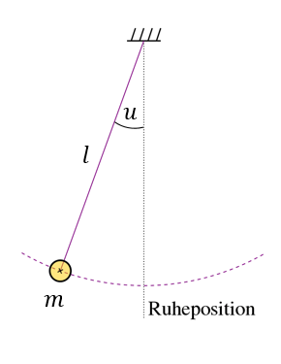
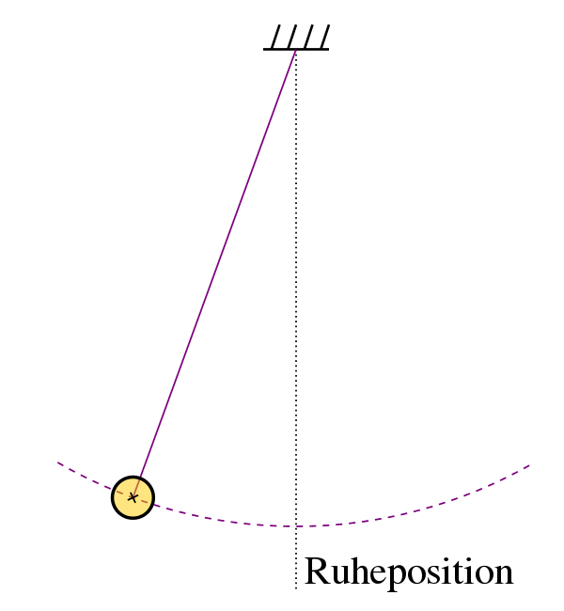
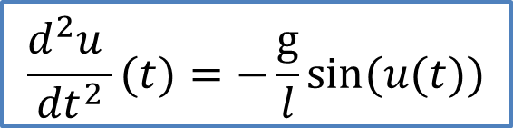
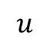
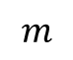
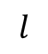
Background
A simple quantitative (mathematical) description of physical systems is possible if they have
high symmetry
no coupling
few interactions
→ Less symmetrical systems and coupled system with many interactions not easily accessible
$$u$$
$$l$$
$$\frac{d^{2}u }{{dt}^{2}}(t)=−\frac{\text{g}}{l}\sin{(u(t))}$$
$$m$$
Notes:
https://de.wikipedia.org/wiki/Pendel#/media/File:Pendelschwingung.gif

Slide 4
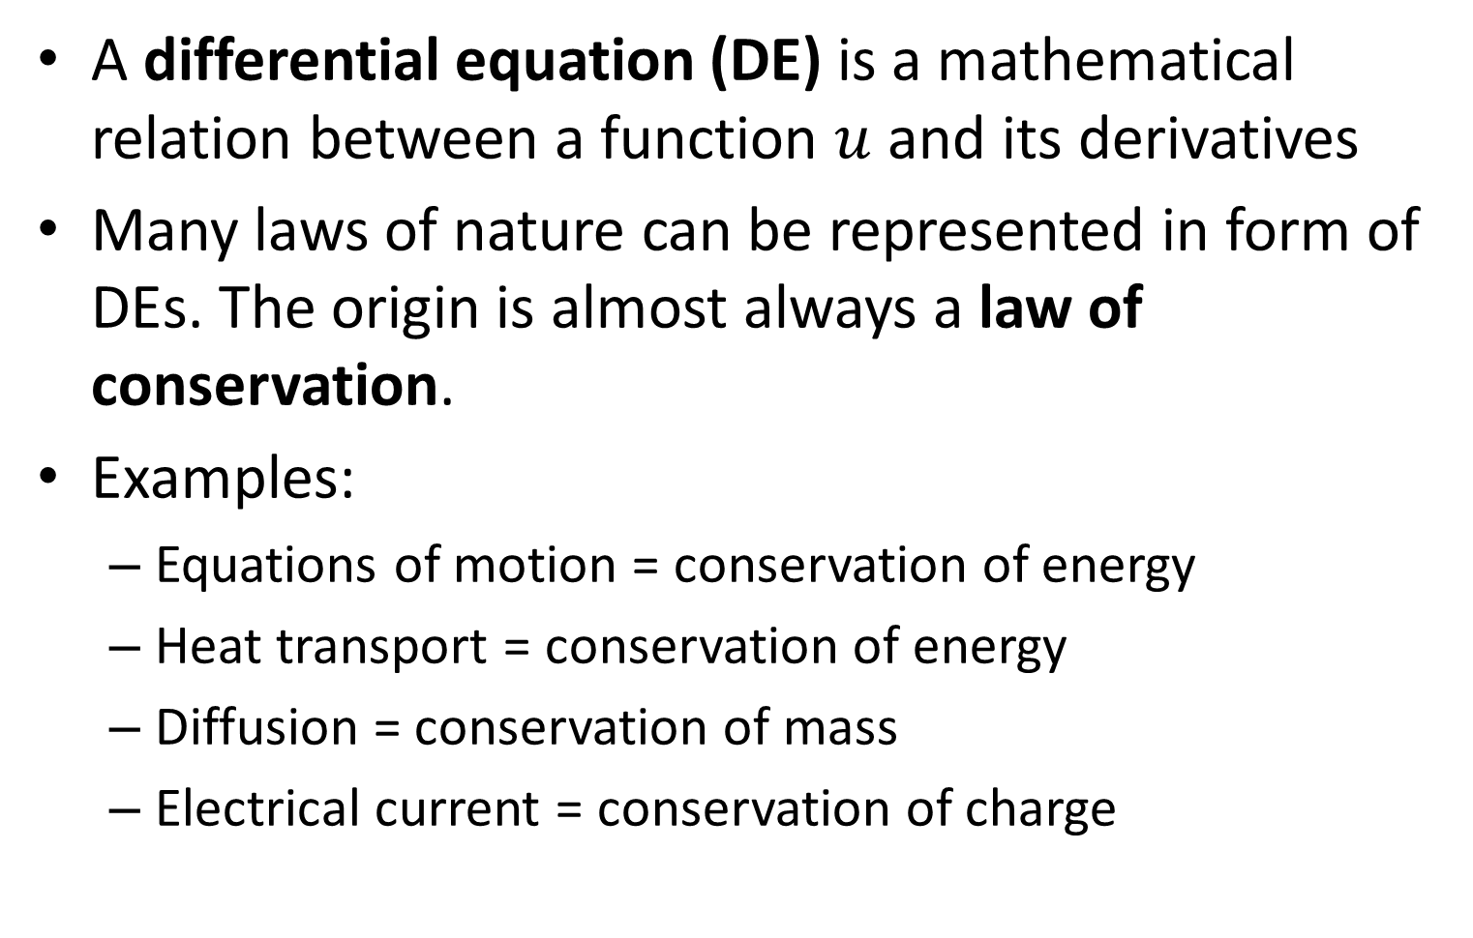
Differential equations
A differential equation (DE) is a mathematical relation between a function $u$ and its derivatives
Many laws of nature can be represented in form of DEs. The origin is almost always a law of conservation.
Examples:
Equations of motion = conservation of energy
Heat transport = conservation of energy
Diffusion = conservation of mass
Electrical current = conservation of charge

Slide 5
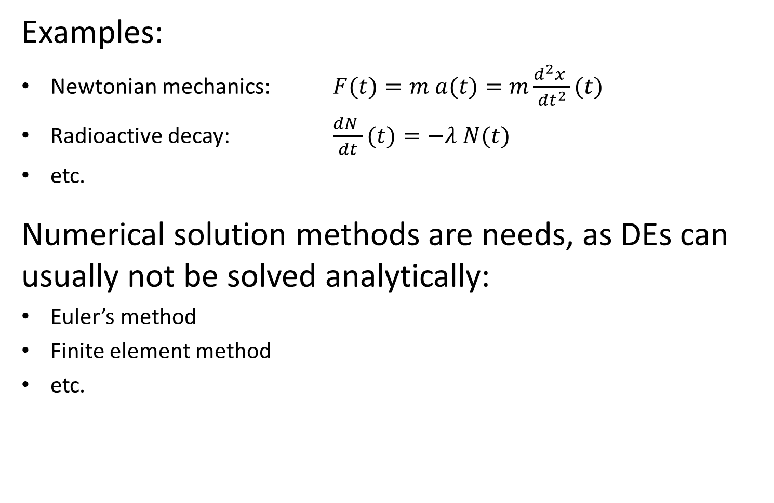
Ordinary differential equations
Examples:
Newtonian mechanics: $F(t)=m a(t)=m\frac{d^{2}x }{{dt}^{2}}(t)$
Radioactive decay: $\frac{dN }{dt}(t)=−λ N(t)$
etc.
Numerical solution methods are needs, as DEs can usually not be solved analytically:
Euler’s method
Finite element method
etc.

Slide 6
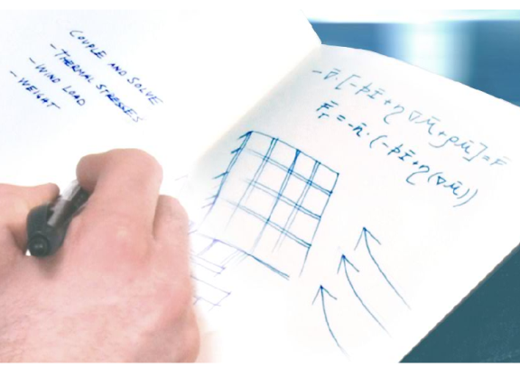
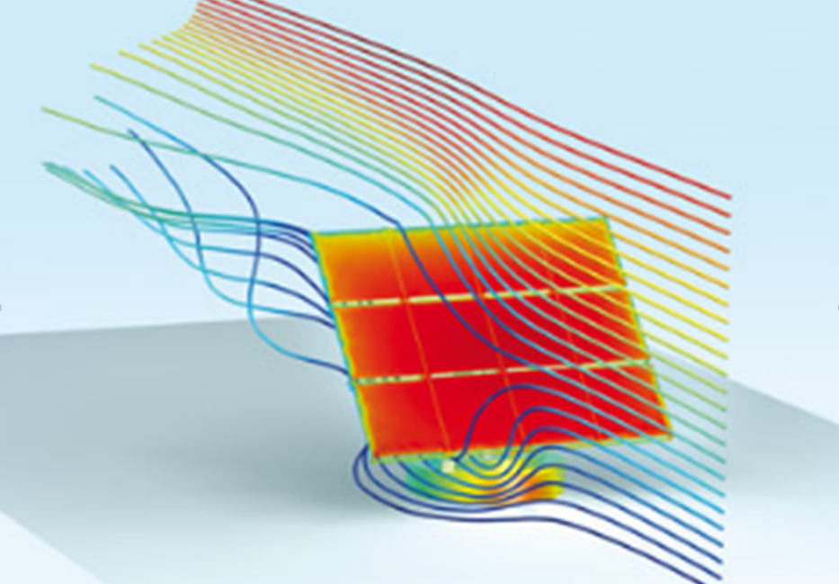
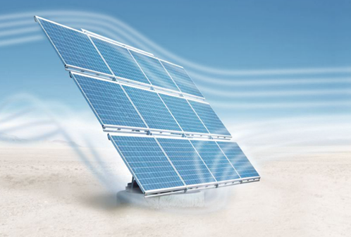
Motivation for simulation
theory
simulation
real system
mathematical models
ordinary and/or partial differential equations
virtual experiments
new design concepts
parameter studies
optimization
expensive & time consuming
only few are realized
Abb. © COMSOL AB

Slide 7
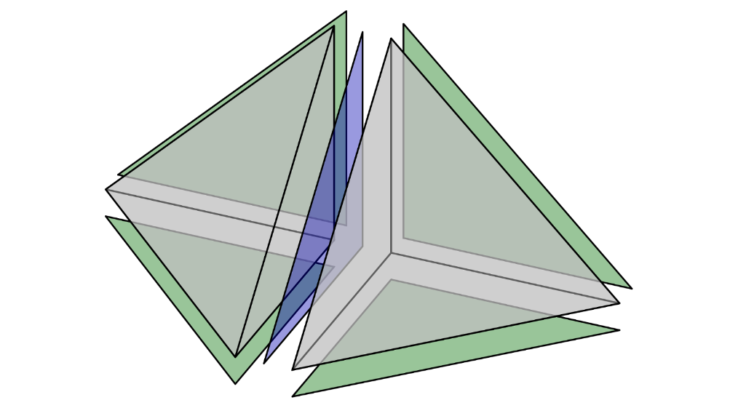
Simulation
Euler method
Used for dynamical processes
Finite element method
Established mathematical method
allows
arbitrary geometries
complex physical laws
various interactions
„what would be if?“ experiments

Slide 8
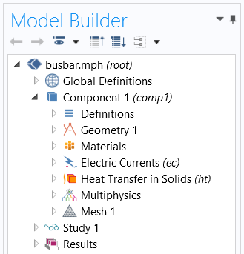
Simulation process
Selection of spatial dimension
Creation of Geometry
Assignment of physical properties
Differential equations
Boundary conditions
Assignment of materials parameters
Meshing / approximation of the solution
Numerical Solution
Evaluation of the results

Slide 9
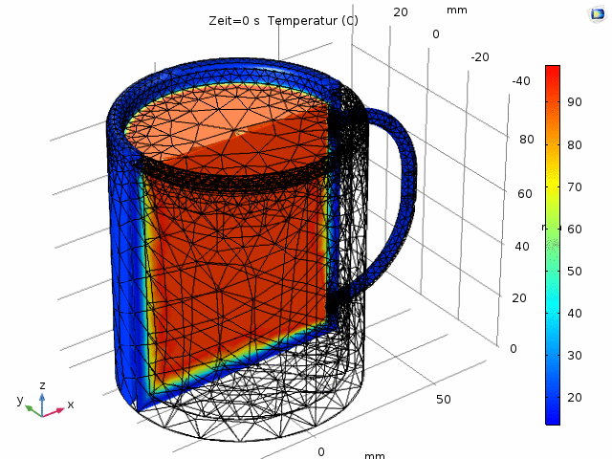
Temperature evolution in cup

Slide 10
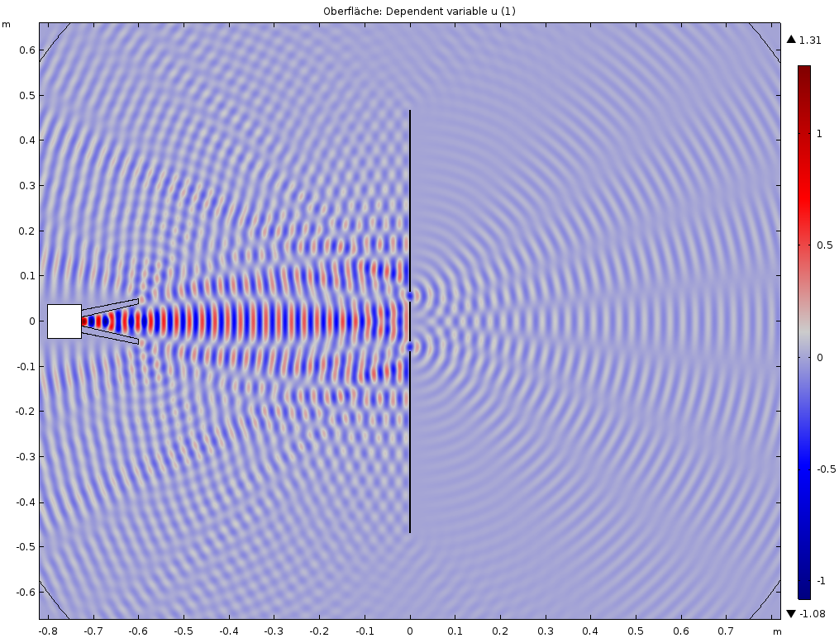
Doppelspalt

Slide 11
Ablauf
Montag | Dienstag | Mittwoch | Donnerstag | Freitag
Individuelle Anreise | Finite-Elemente-Methode | Eindimensionale Schwingungen Euler-Verfahren | Mehrdimensionale Analysis Wellengleichung für elektromagnetische Wellen | Experiment und Simulation Mikrowellen
 | Mittagessen
Einführung (13:00) Differenzial-gleichungen in der Physik | Experiment und Simulation Wärmeleitung | Experiment und Simulation Pendel Studieninformation | Experiment elektromagnetische Wellen | Individuelle Vertiefung Abschluss
Abendessen (19:00) | Abendessen (19:00) | Abendessen (18:00) Astro-Abend (19:30) | Abendessen (18:00) | Individuelle Abreise (ab 16:00)

Slide 12
Notebook use
Login data
User: kurs3/xlab222
Passwort: startstart
Storage location for central course materials
(read only)
Network drive: Z:\Physik\Numerical Simulation of Physical Systems
Storage location for own course material
C:\Users\Public\Documents\YourName

Slide 14
Hidden figures

Slide 15
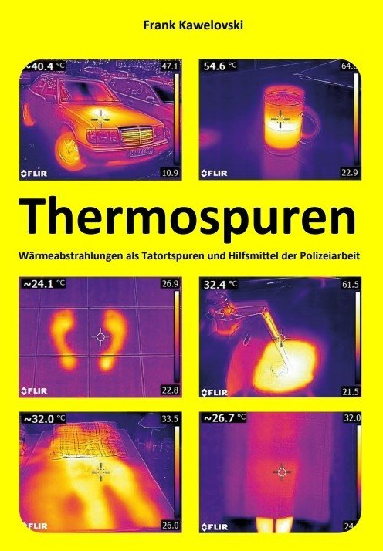

Slide 16
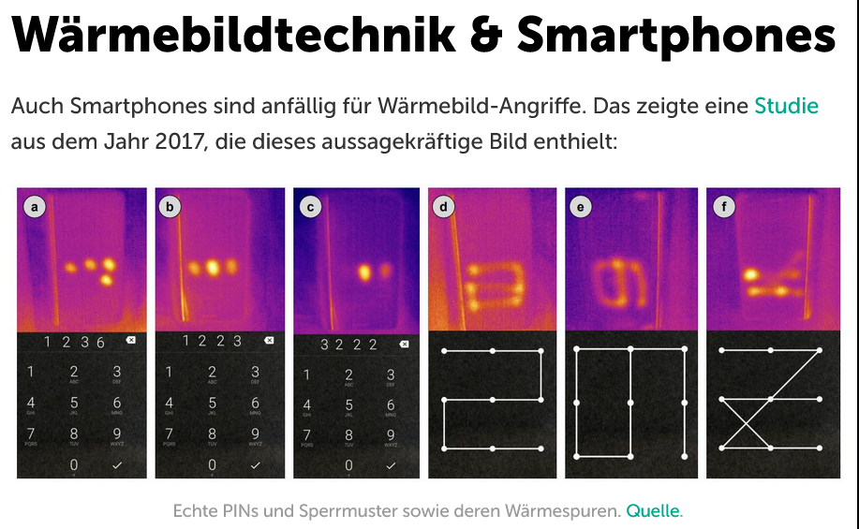
Stay Cool! Understanding Thermal Attacks on Mobile-based User Authentication DOI: 10.1145/3025453.3025461

Slide 17
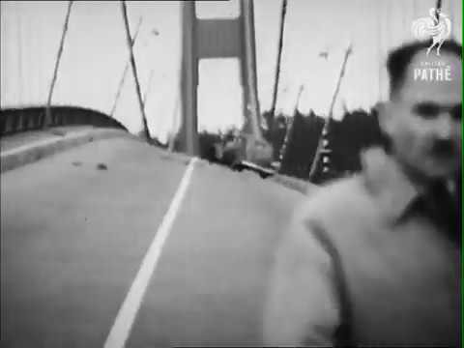

Slide 18
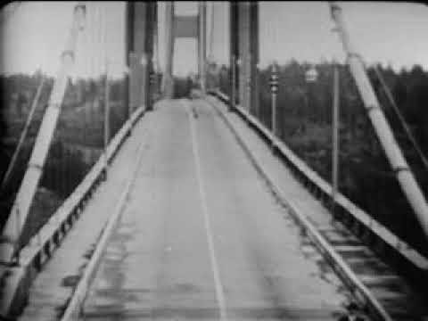

Slide 19
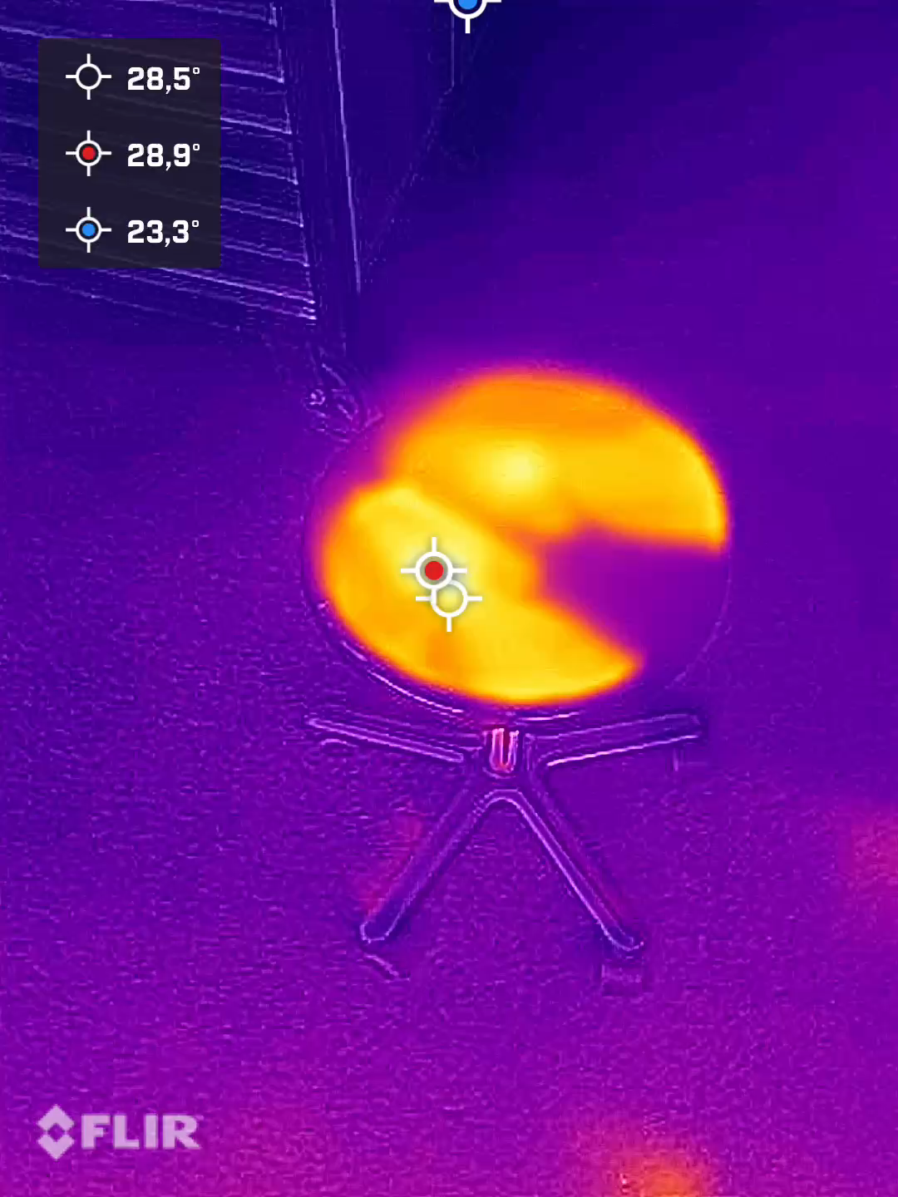
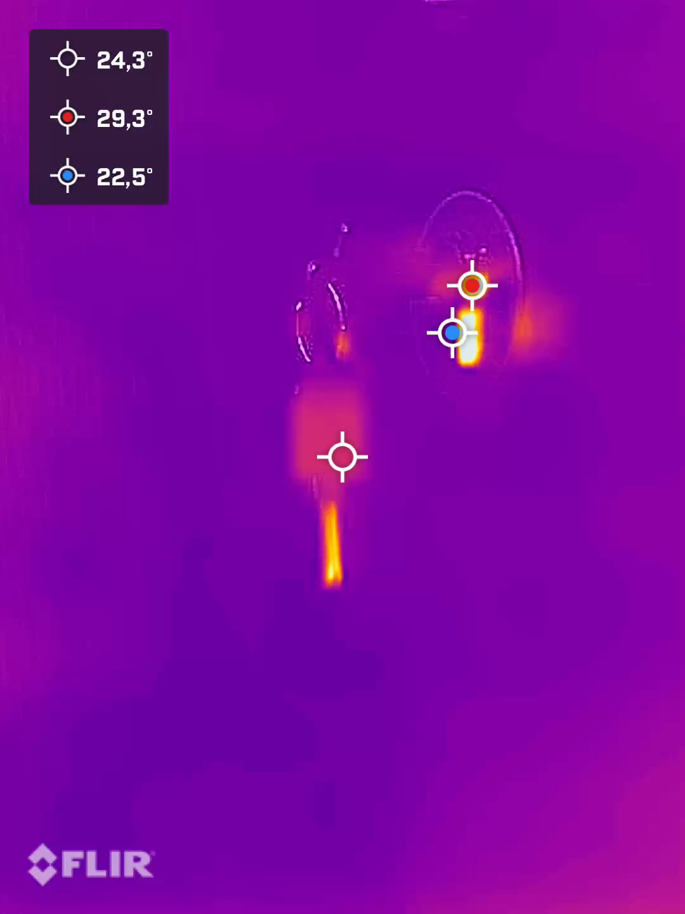
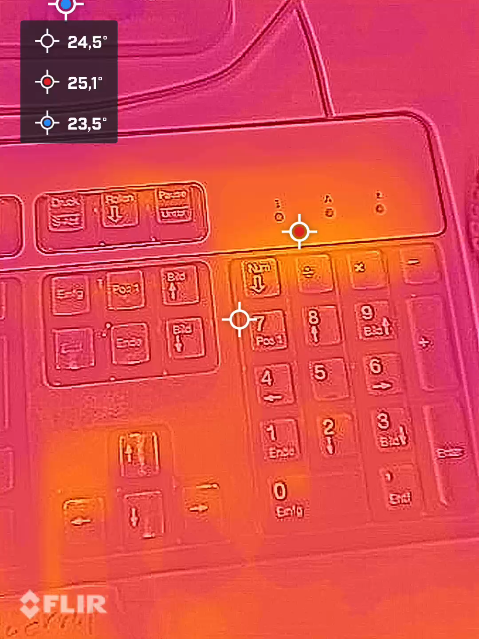
Fragestellungen
When did the person leave?
When was the key left in the door?
How long is the PIN visible?

Slide 20
Feedback zu
Verteilung der Arbeitsformen (Theorie, Übungen, Simulation, Experimente)
Dozentenvortrag versus selbständiger Arbeit
Verteilung der Schwerpunkte (Mathematik, Physik)
Eingesetzte Medien (jupyter, comsol, …)
Inhaltlicher Breite versus fachlicher Tiefe
Ankündigung des Kurses versus tatsächlicher Inhalt
Arbeitsatmosphäre

